Slide 1
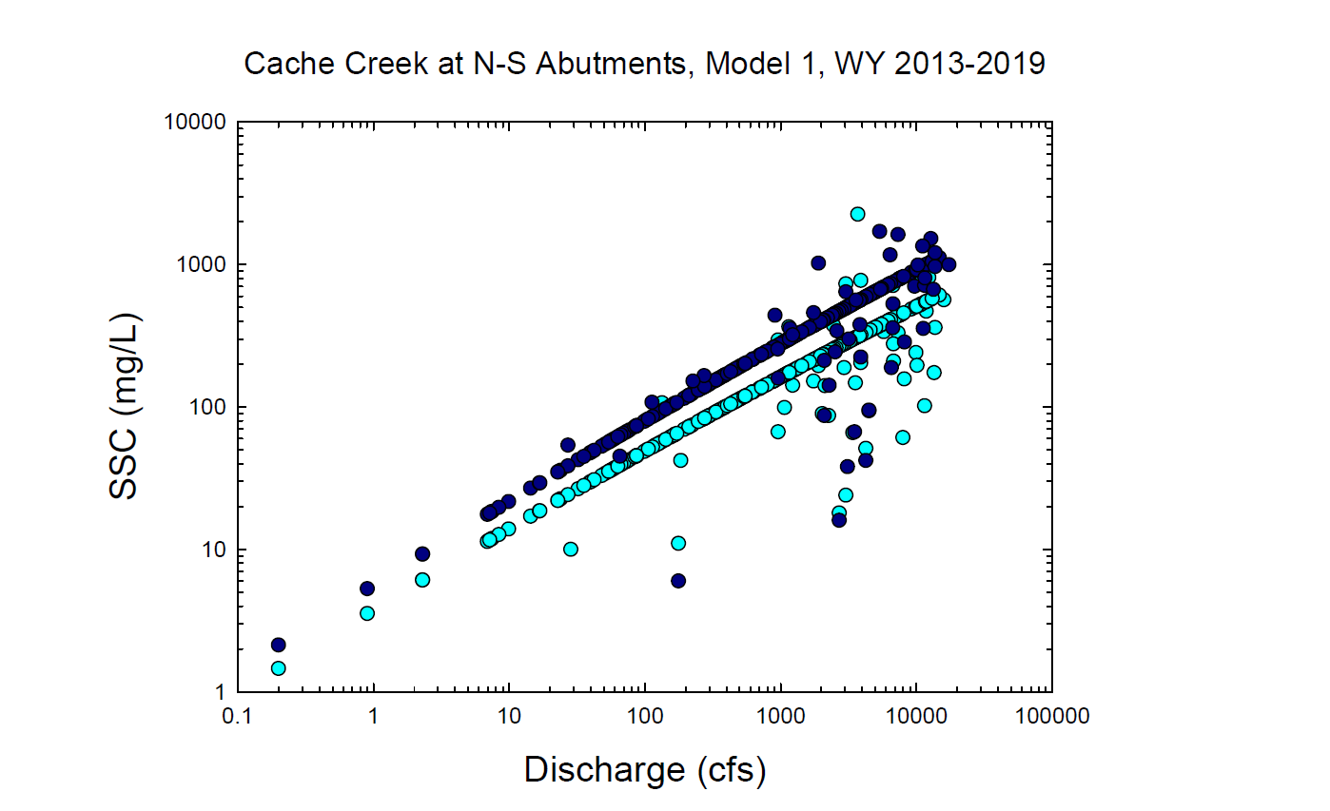
Dk. Blue circles = South Abutment Observed and Modeled values
Lt. Blue circles = North Abutment Observed and Modeled values

Slide 2
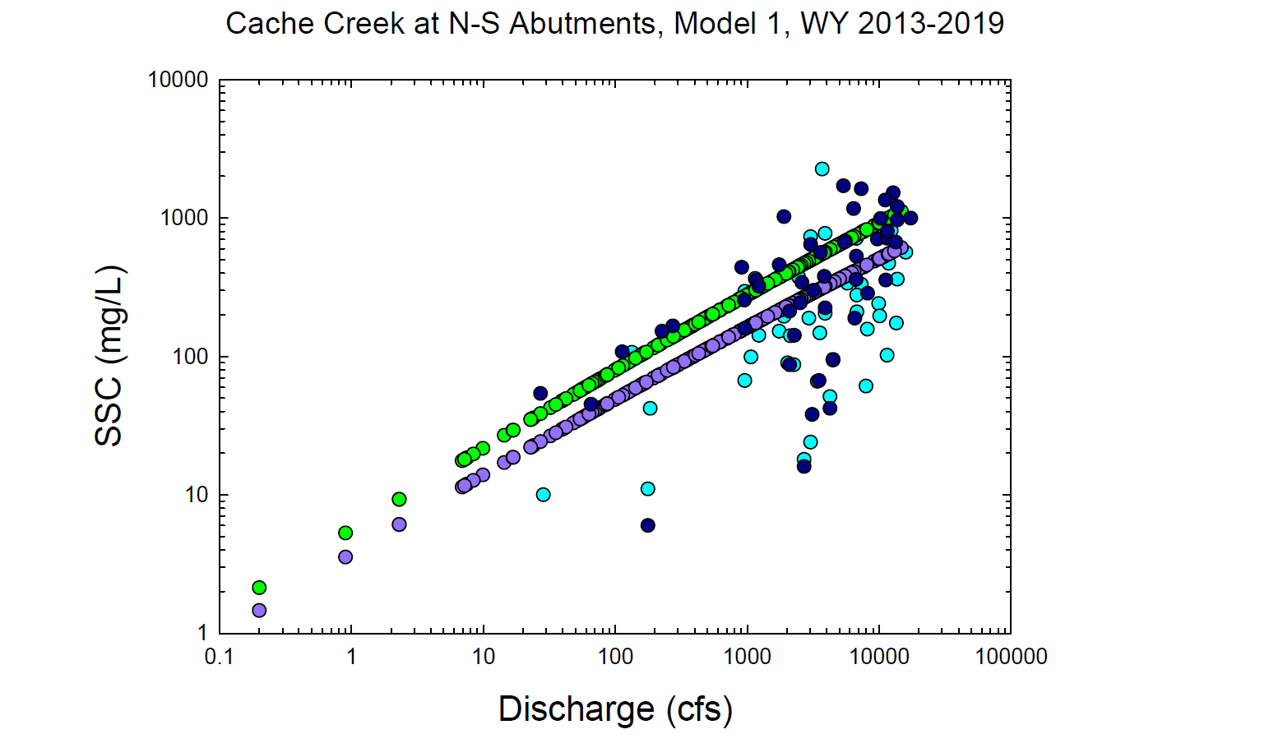
Dk. Blue = Observed South Abutment
Lt. Blue = Observed North Abutment
Green = Modeled South Abutment
Purple = Modeled North Abutment

